Slide 1
Employee Performance Analysis Using Excel
PRESENTED BY: DINOS I
REGISTER NO : 312204463
DEPARTMENT : COMMERCE
COLLEGE : K.C.S KASI NADAR COLLEGE OF ARTS AND SCIENCE

Slide 2
PROJECT TITLE
Employee Performance Analysis Using Excel

Slide 3
AGENDA
1.Problem Statement
2. Project Overview
3.End Users
4.Our Solution and Proposition
5. Dataset Description
6. Modelling Approach
7. Results and Discussion
8.Conclusion

Slide 4
PROBLEM STATEMENT
Analyze and report the distribution of employee performance based on their IDs, categorized into 'Fully Meets,' 'Needs Improvement,' or 'blank' if no specific category data is provided. The goal is to determine the total count of employee IDs in each performance category, as well as the overall distribution of employee performance across all categories."

Slide 5
PROJECT OVERVIEW
[Employee Performance Improvement and Pay Zone Optimization]
Data Categorization
Analysis of Distribution
Grand Total Comparison
Identifying Gaps
Reporting Insights

Slide 6
WHO ARE THE END USERS?
Human Resources (HR) Department
Department Managers (Sales & Production)
Senior Leadership/Executives
Employees
Finance/Compensation Teams

Slide 7
OUR SOLUTION AND ITS VALUE PROPOSITION
Filtering - Remove missing values.
Conditional Formatting - Blanks, Background Color Shading, Data Bars, Values.
Data Filtering and Sorting - Identify specific employee groups, such as those with exceeds, needs improvements and fully meets.
Pivot table - Summary of employee performance under their current rating .
Graphs - FINAL REPORT.

Slide 8
DATASET DESCRIPTION
EMPLOYEE ID: Unique identifier for each employee in the organization.
FIRST NAME: The first name of the employee.
Performance Score: A score indicating the employee's performance level (e.g., Excellent, Satisfactory, Needs Improvement).

Slide 9
MODELLING
DATA SET: Kaggle, Employee dataset.
FEATURE SELECTION: Slicer, Conditional Formatting, Designing.
DATA CLEANING: Missing values, Irrelevant data, Correct Errors, Remove Unnecessary Columns and Rows.
PIVOT TABLE: Employee ID, First Name, Pay zone, Department Type, Current Employee Rating.
CHART: Report of Employee Performance based on their Employee Id is represent in Values and Performance Score presented as Column Chart..

Slide 10

RESULTS

Slide 11

CONCLUSION
Distribution of Employee Performance:
The majority of employee IDs (27,856) are categorized under "Fully Meets," indicating a positive performance trend.
A smaller subset of IDs (6,959) falls under "Needs Improvement," which is significantly less compared to those categorized as "Fully Meets."
Data Integrity:
The grand total of all employee IDs (34,815) aligns with the sum of the categorized IDs, suggesting accurate data aggregation.
Performance Insights:
The data suggests that most employees are performing at an acceptable level ("Fully Meets"), while a smaller portion requires improvement.
This distribution indicates a generally strong performance across the workforce, but it also highlights a segment that might need additional support or intervention.

Slide 12
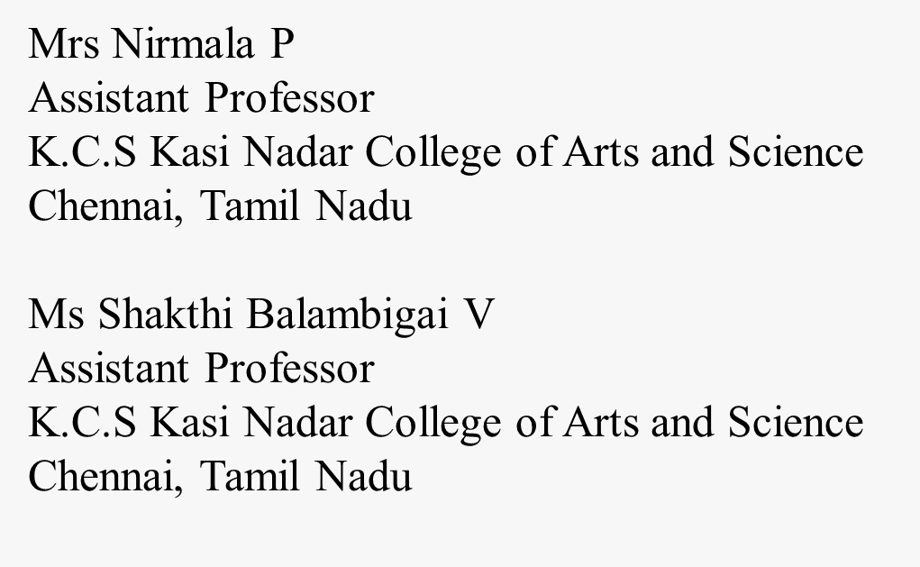
REFERENCE

